Slide 1
Mobike
Dock less bicycle sharing services
Since Jan, 2015
Mó bài dānchē (摩拜单车)

Slide 2
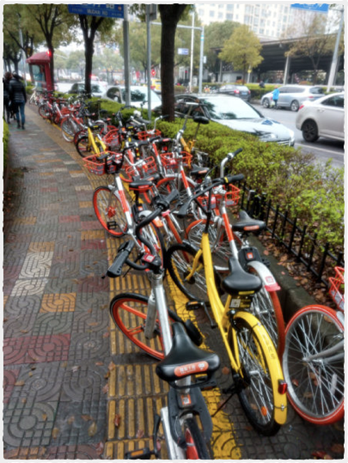

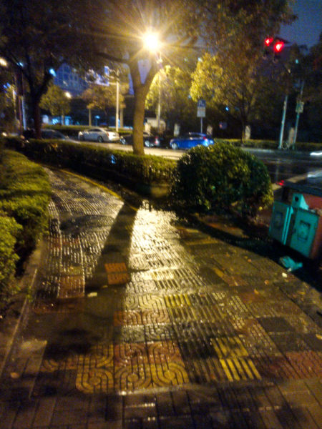
Day
Night

Slide 3
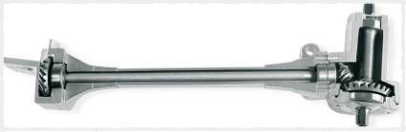
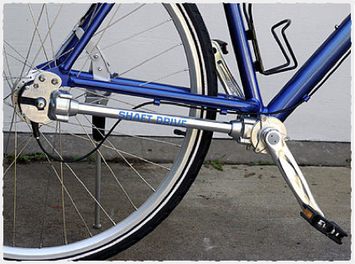
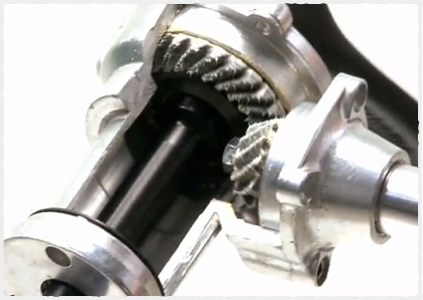
Shaft-drive
Uses a drive shaft instead of a chain to transmit power from the pedals to the wheel.

Slide 4
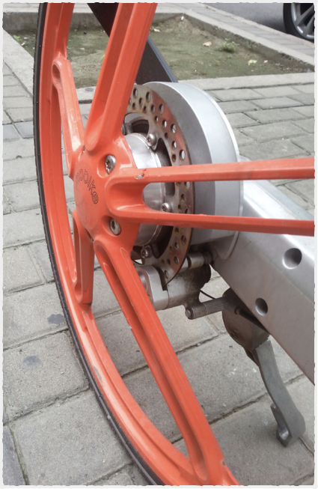
Disc brake
Can withstand over 10,000 kilometres of riding without failure.

Slide 5

All is well!
A machine is anything that reduces human effort and reduces time.

Slide 6
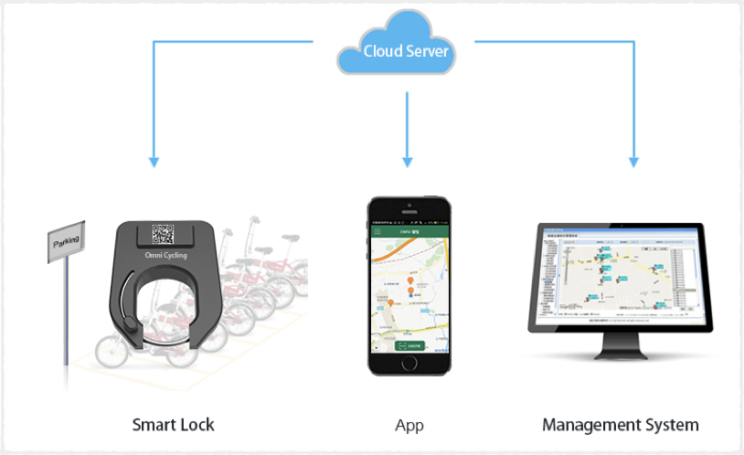
Who manages the requests?
Your app communicates with the lock via management system

Slide 7
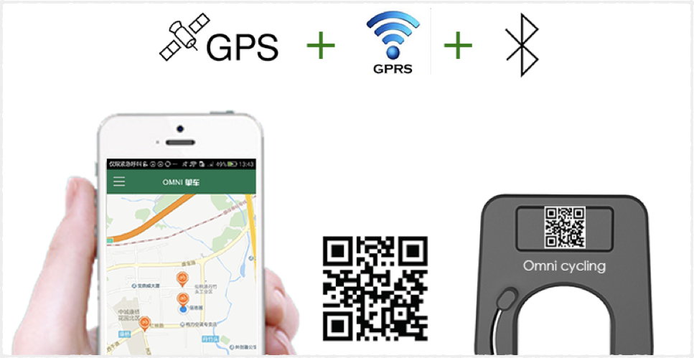
How does the lock work?
The lock contains a GPS, can connect to GPRS as well as Bluetooth

Slide 8
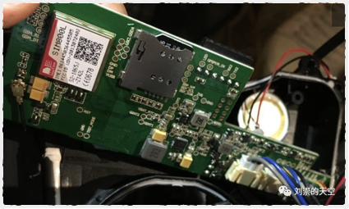
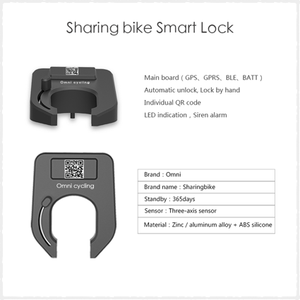
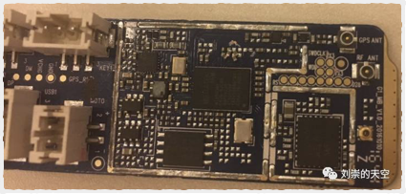
Mobike Lock
BlueGoGo Lock

Slide 9
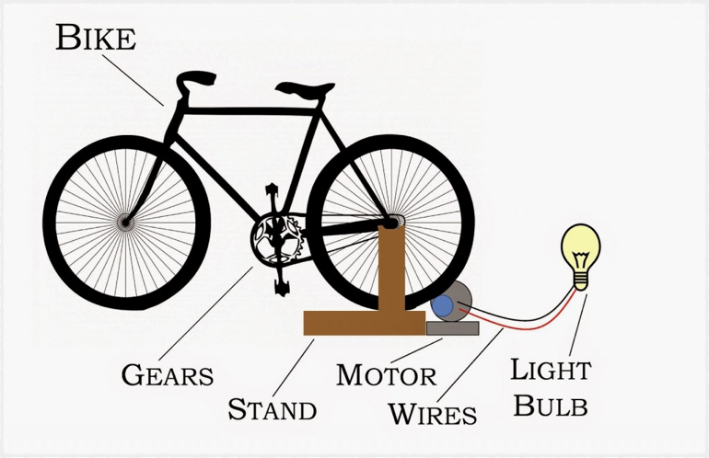
Kinetic Energy
Generators convert kinetic energy to electricity

Slide 10
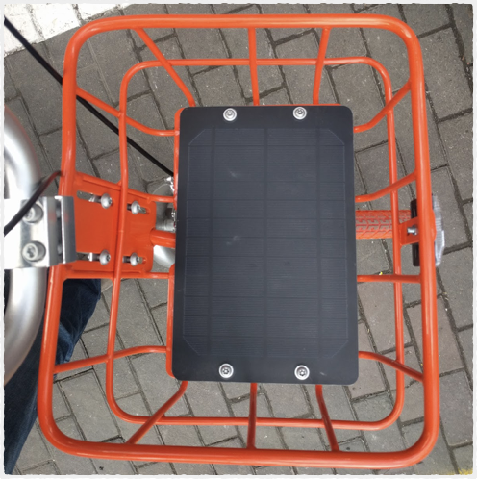
Solar energy
Absorbs sunlight as a source of energy to generate electricity

Slide 11
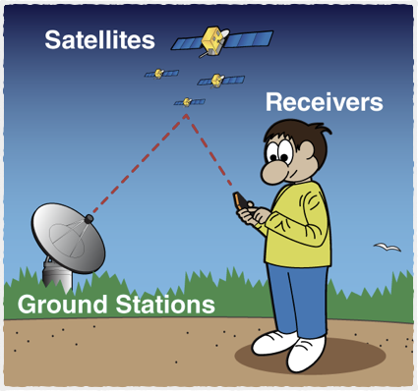
How does GPS work?
Global Positioning System

Slide 12
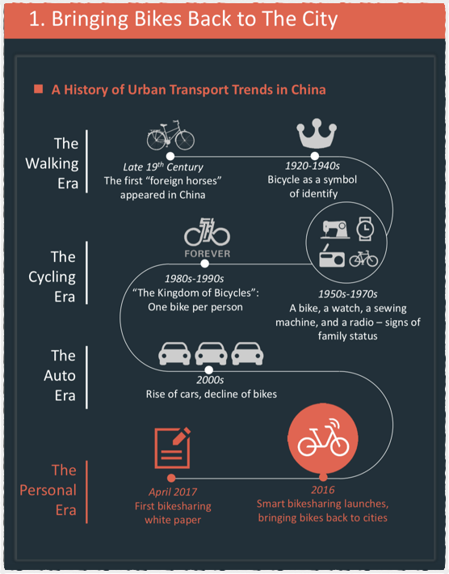

Slide 13
Thank you
Keep learning, how stuff works

